Slide 1

Project Presentation On
WEB ENABLED FINGERPRINT BASED ELECTRONIC VOTING MACHINE FOR PRIVATE COMMUNITIES
Group Number:15
Presented by
Brijesh Nishad : 2101321550026
Ashutosh : 2101321550021
Aayush Pandey : 2101321550001
Under the Supervison of Mr. Rajat Kishor Varshney
(Department of CSE-IoT , GNIOT Greater Noida,India)

Slide 2
Table of Contents
Abstract
Introduction
Problem Statement
Objectives
Flow Diagram
Literature Review
Proposed System
Hardware Components
Results and Discussion
Conclusion

Slide 3
Abstract
Brief overview of the project
Emphasis on secure, efficient, and accessible voting
Use of biometric authentication (fingerprint)
Web-enabled for remote results access or administration
Core innovation: Fingerprint authentication + Web integration
Designed to make voting secure, real-time, and transparent

Slide 4
Introduction
Voting is crucial for democratic processes even in small communities
Traditional voting methods are prone to fraud and inefficiencies
Lack of automation leads to time delays and human errors
Biometric systems help verify identity with high accuracy
Web-based systems improve transparency and result access
Integration of both enhances trust and efficiency in elections

Slide 5
Problem Statement
Lack of authentication leads to voting fraud
No online result access
Delays and manual errors are common
Manual voting systems are time-consuming and error-prone
Identity fraud and multiple voting are common issues
Difficulty in managing and securing paper ballots
No centralized way to access or monitor results remotely

Slide 6
Objectives
Develop an electronic voting system with biometric authentication
Ensure one-person-one-vote using fingerprint verification
Provide web access for real-time monitoring and results
Enhance voting security and prevent impersonation
Make the system scalable for small communities and events

Slide 7
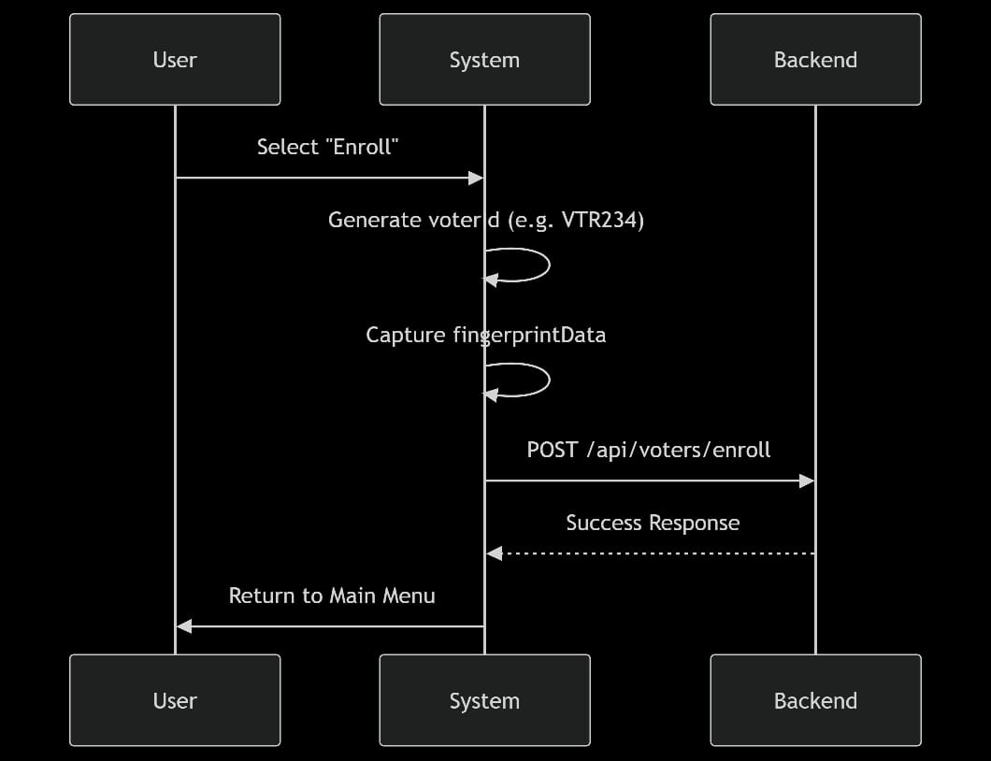
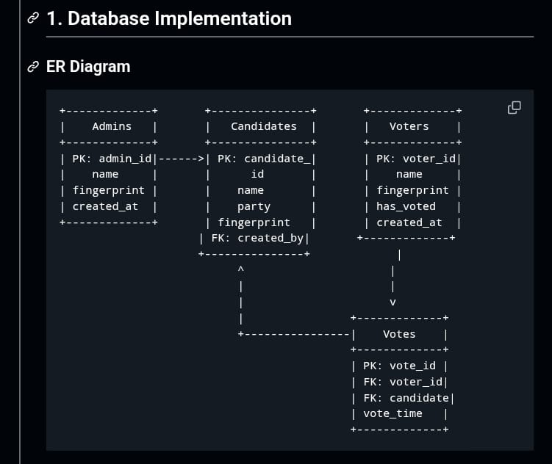
Flow Diagram

Slide 8
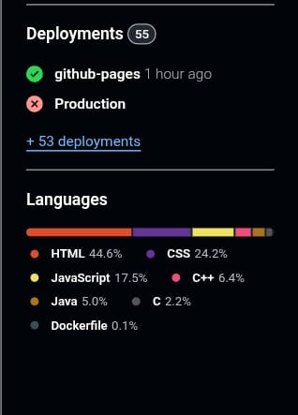
Literature Review (Related Work)
Traditional paper and EVMs lack biometric verification
Some systems use biometrics but are not web-enabled
Online voting platforms often lack secure ID verification
Existing systems suffer from data security issues
Limited use in private, local community settings
High cost and complexity limit adoption

Slide 9
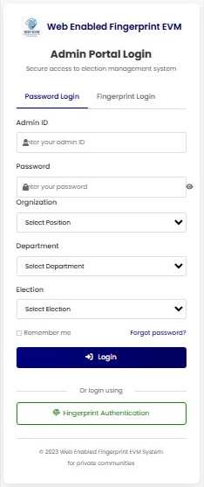
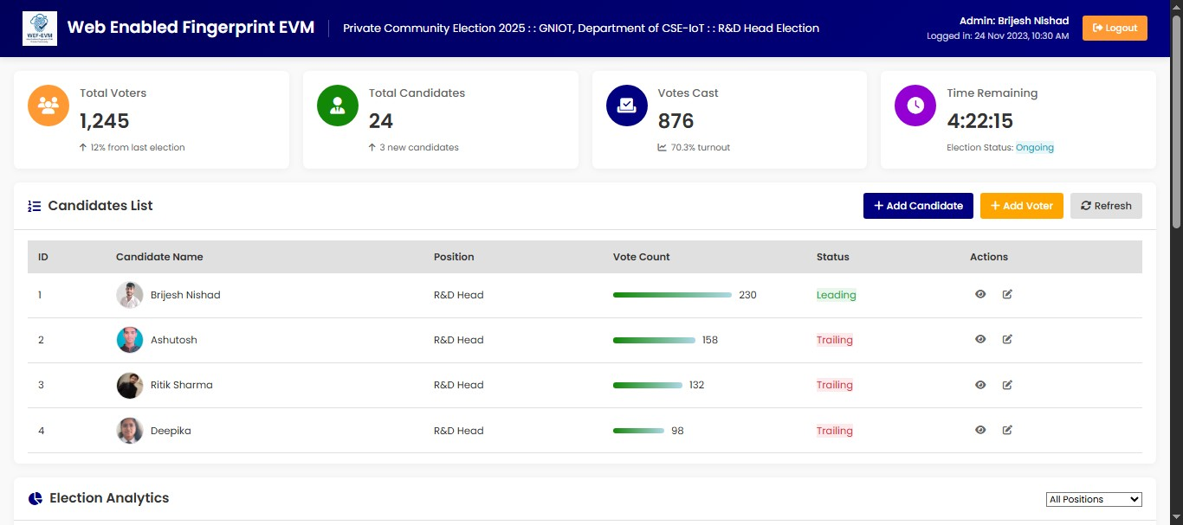
Proposed System Overview
Dashboard
Admin Portal Login

Slide 10
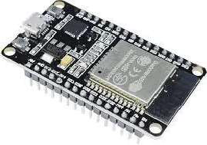
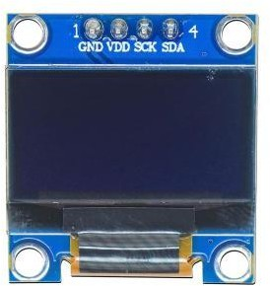
Hardware Components
ESP32 OLCD Module
Built-in Wi-Fi
Low Cost
Open source
Community and Library Support
Alphanumeric Display 16x2 Format
Parrallel Communication Low Power Consumption

Slide 11
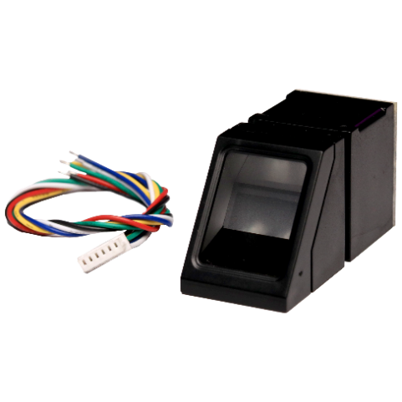

Fingerprint Scanner
LED
Finger print scanner
Collection of Data
High Senstivity
Low Cost
Shows system power/status
Indicates successful fingerprint scan
Alerts for invalid votes
Blinks during vote casting
Green = Success, Red = Error

Slide 12
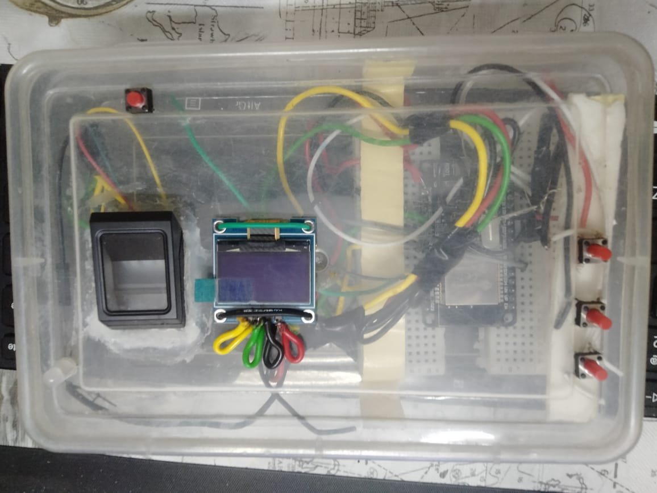
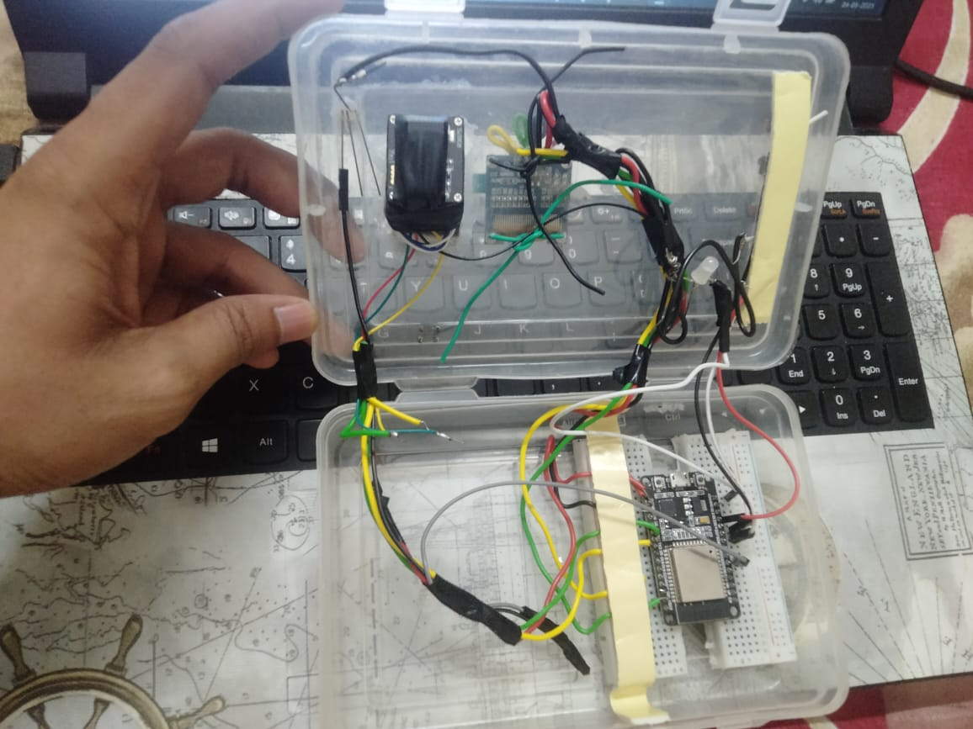
EVM Model

Slide 13
System Architecture
Fingerprint sensor verifies voter identity securely.
Microcontroller (e.g., ESP32/Arduino) processes input and connects to the internet via Wi-Fi.
Cloud server stores votes and displays live results through a web dashboard.
Voting status and messages are shown on an LCD display.

Slide 14
Experimental Setup
Voting Prototype: Built using NodeMCU (or Arduino/ESP32) with integrated biometric and connectivity modules.
Test Environment: Simulated voting conditions with multiple users, fingerprint verification, and vote casting scenarios.
Power Supply: Stable power setup ensures continuous operation of sensors and system components.
Test Scenarios:
Valid and invalid fingerprint input
Multiple voting attempts
Real-time web result updates
Wi-Fi disconnection and reconnection
Admin result access from remote device

Slide 15
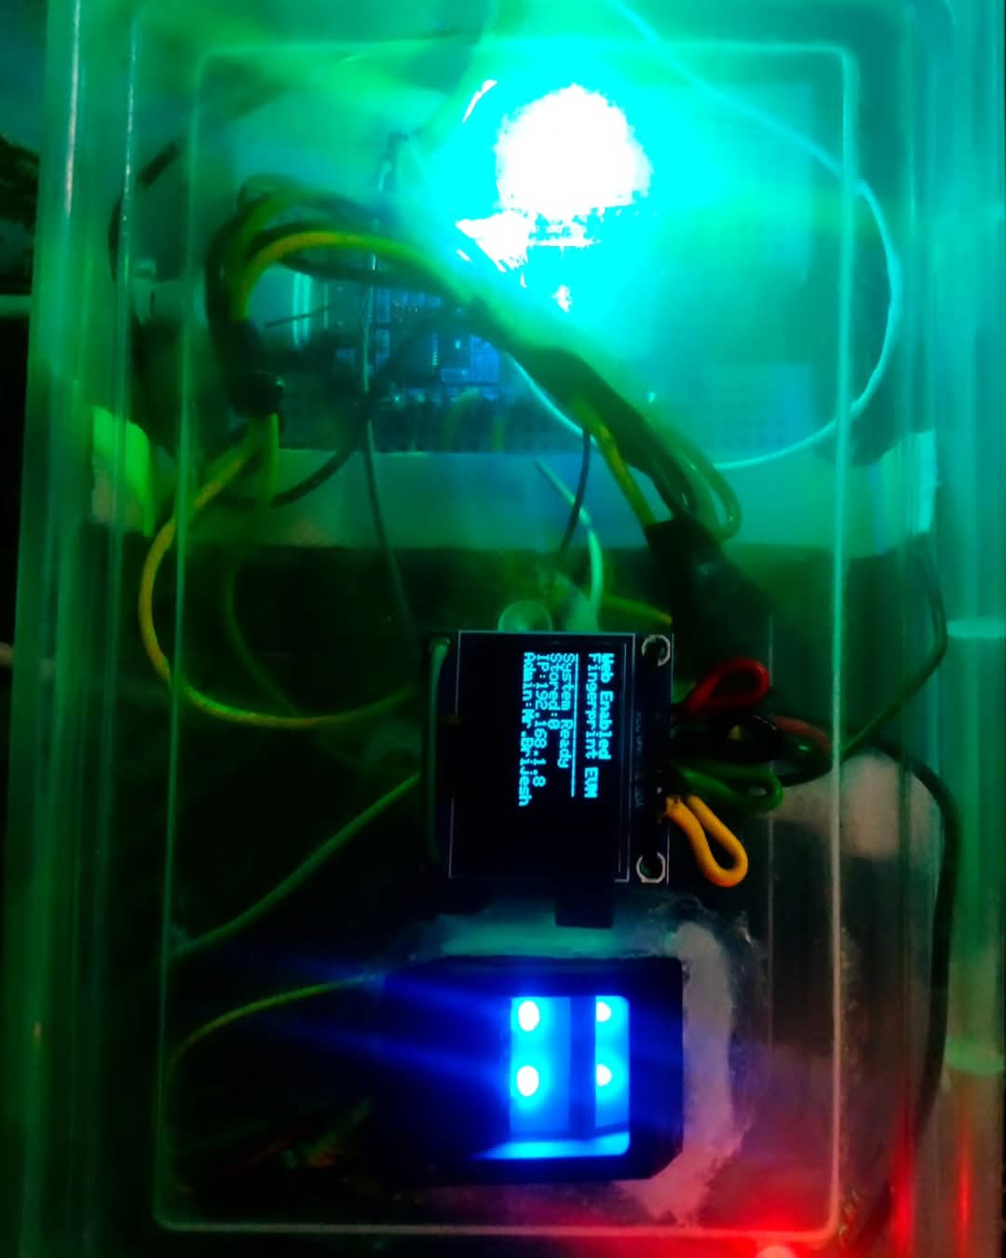
Results & Discussion
Effective Monitoring: Fingerprint sensor accurately verifies voter identity to prevent fraud.
System promptly indicates invalid fingerprints or multiple voting attempts via LEDs.
Web Advantage: Enables real-time remote monitoring of votes and instant result updates through the web dashboard.

Slide 16
Conclusion
The web-enabled fingerprint voting system improves election security through real-time voter authentication.
Accurately verifies voter identity, preventing unauthorized or duplicate votes.
Provides fast, local alerts (LED/buzzer) and remote notifications via the web dashboard for administrators.
Future deployment in real private communities will validate practical effectiveness and user acceptance.

Slide 17
Thank You

